Slide 1

Getting Started with Robotpy
JT Moore Chicago Knights 1739

Slide 2

JT
Digital Forensics/Incident Response @ Motorola Solutions
Lead Programming mentor CK 1739
18 Years of FIRST
Breaker of things (sometimes on purpose)
Googles “How to write for-loop”

Slide 3
Installation (Python)
Download python
https://www.python.org/downloads/
Windows: Make sure you check “Add to PATH”
Verify Install by typing “python --version”
3.6.x+ is groovy
2.x is less than stellar, try typing “python3 --version”
If “python3” worked then every time we use “python” or “pip” replace it with “python3” or “pip3”

Slide 4
Installation (Configuring tools)
From anywhere in your terminal:
upgrade pip python -m pip install --upgrade pip
Download Build Tools
https://docs.microsoft.com/en-US/cpp/windows/latest-supported-vc-redist?view=msvc-170

Slide 5
Hello World, But Make it Sparkle
Notes:
Create a program that writes hello name
Create a program that writes hello variable
Create a program that counts the number of users over 17 (https://github.com/chuck-codes/how2Python/blob/main/userDB.txt)

Slide 6
You’re Doing Great

Slide 7
What about robotPy?
PC Install
Robot Install
Vendor Specific Libraries

Slide 8
Installation (PC Install)
Download python [Done]
Download robotpy
py -3 -m pip install robotpy[all]
Upgrade robotpy
py -3 -m pip install --upgrade robotpy
Notes:
https://robotpy.readthedocs.io/en/stable/install/computer.html#install-computer

Slide 9
Installation (Robot Install)
Download python for the robot
py -3 -m robotpy_installer download-python
While connected to the robot network
py -3 -m robotpy_installer install-python
Upgrade robotPy on the robot
py -3 -m robotpy_installer download -U robotpy[all]
Notes:
https://robotpy.readthedocs.io/en/stable/install/robot.html
https://robotpy.readthedocs.io/en/stable/install/components.html#robotpy-components

Slide 10
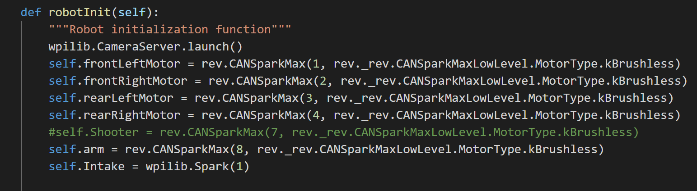
What does the init code look like

Slide 11
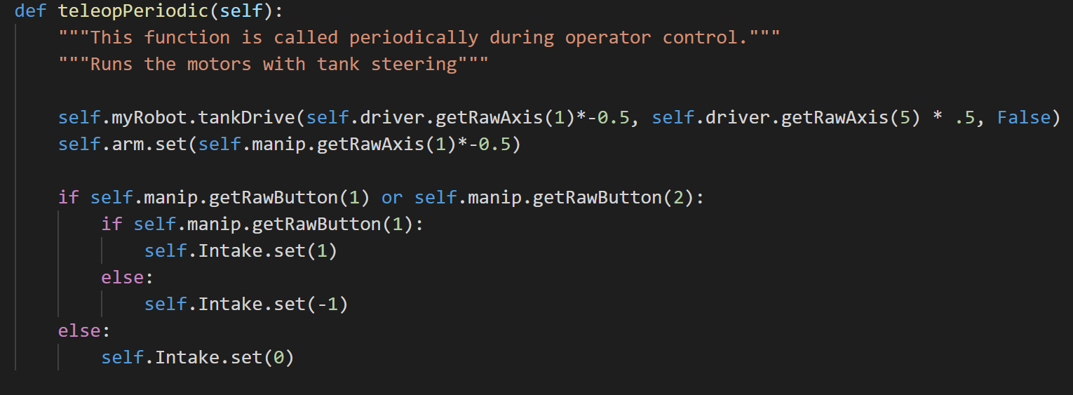
What does the TeleOp code look like

Slide 12
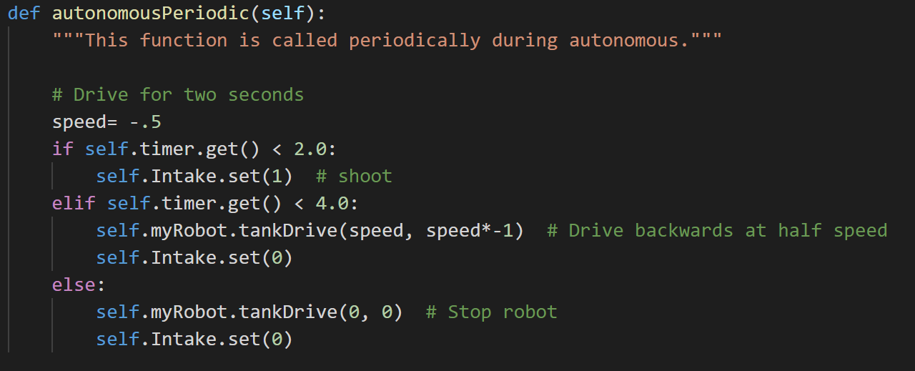
What does the Auton code look like?

Slide 13
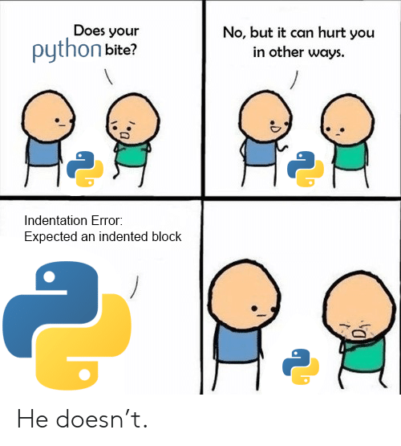
You’re Still Doing Great
If you’re looking for starter code or want to test your skills check back here often

Slide 14
Curious about making the switch?

